Slide 1

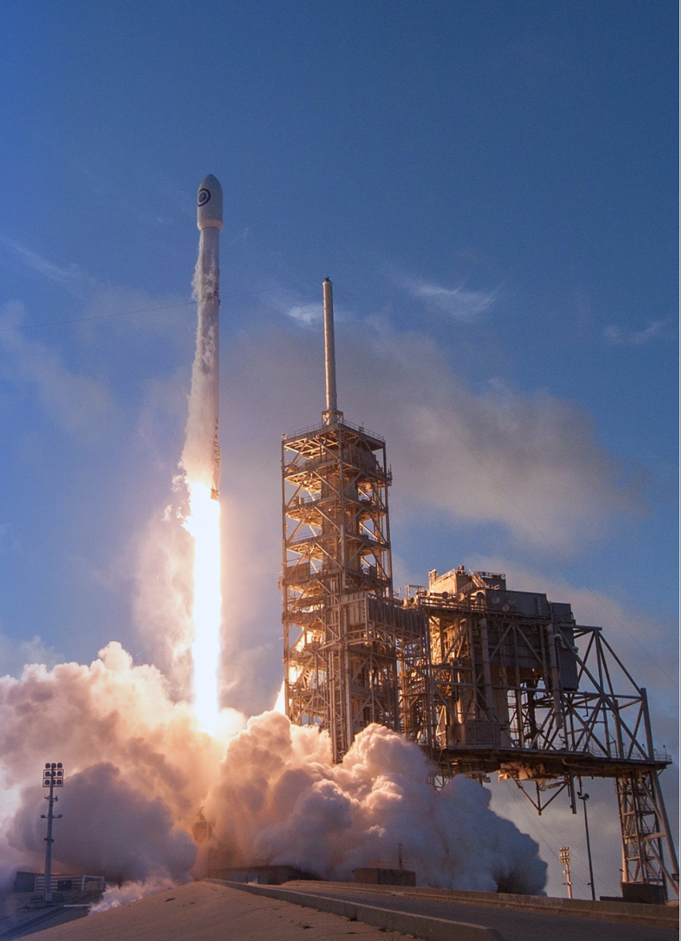
IBM Data Science Capstone Project
Space X Falcon 9 Landing Analysis
Sham Kin Tat Kinder
Github: IBM_Data_Science_Course
Nov 28, 2022

Slide 2
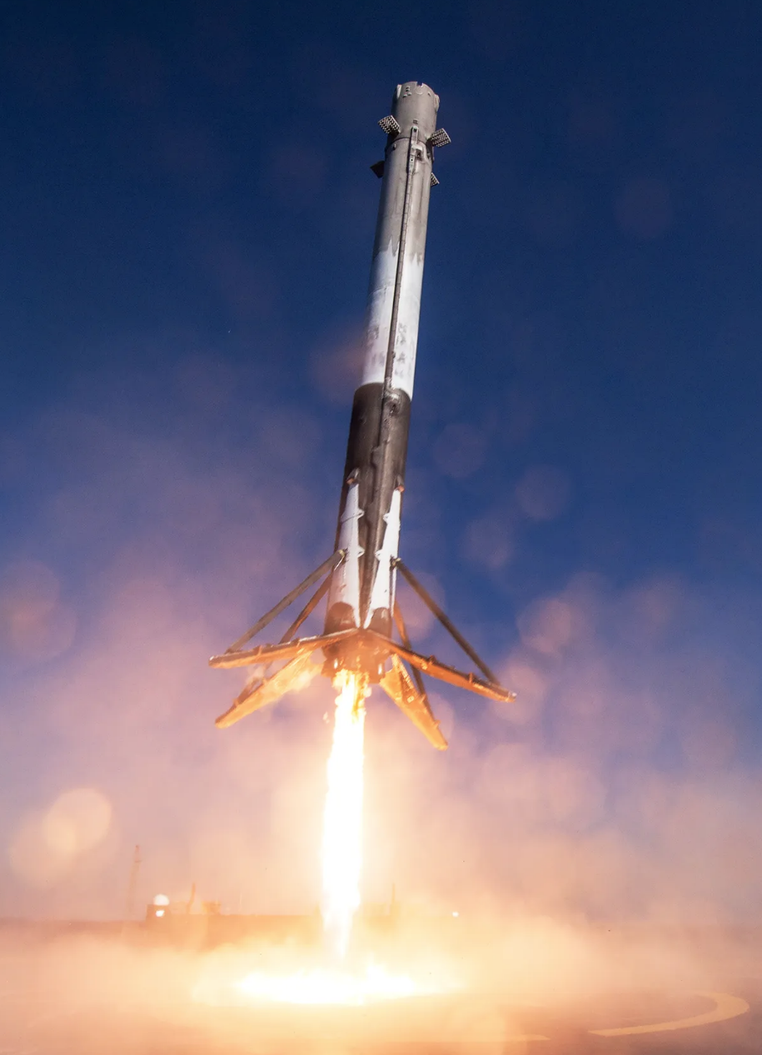
Outline
Executive Summary
Introduction
Methodology
Exploratory Data Analysis
Results
Conclusion
Appendix

Slide 3
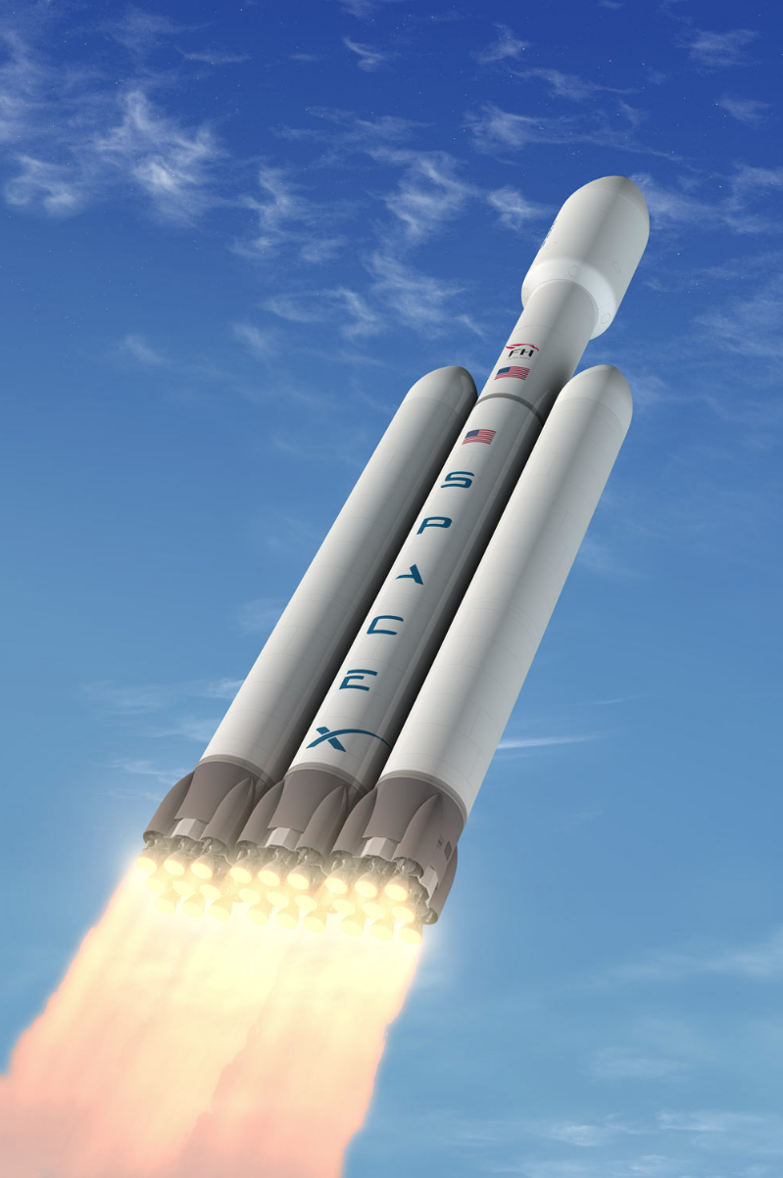
Executive Summary
Summary of methodologies
This project is following the Data Science Process which including:
Data Collection
Data Wrangling
Exploratory Data Analysis
Interactive Visual Analytics
Predictive Analysis (Classification)
Summary of all results
This project produced the following outputs and visualizations:
Exploratory Data Analysis (EDA) results
Geospatial analytics
Interactive dashboard
Predictive analysis of classification models

Slide 4
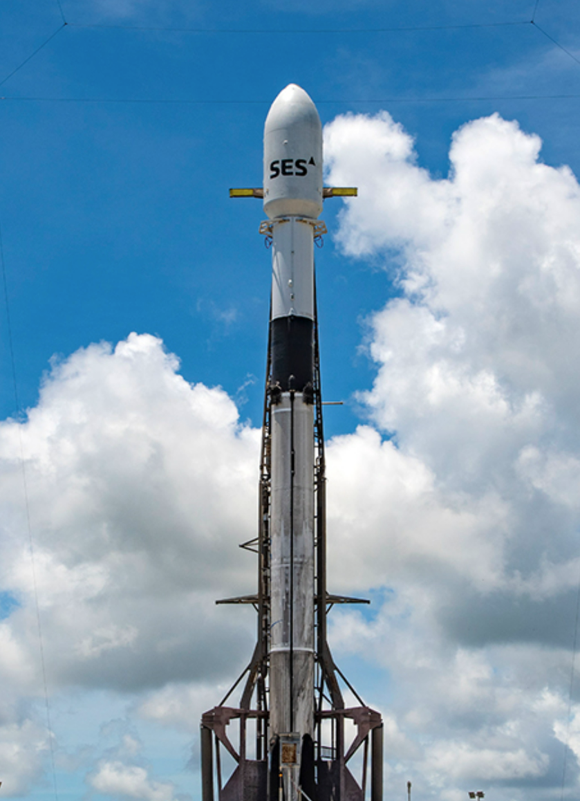
Introduction
Project Background
SpaceX spent about $62 million to launch the Falcon 9 rocket. The cost is much cheaper than other suppliers, more than $165 million, largely because SpaceX can reuse the first stage, which is a saving, so the rocket can be re-launched.
If we can predict whether the first stage can land success or not, we can determine the costs and use that information to evaluate whether alternative companies should bid on SpaceX for the rocket launch.
This project will predict the Space X Falcon 9 first stage can land successfully or not.
Problem Statement
What affects whether a rocket can land successfully?
Which variables will affect the successful landing of the rocket?
What needs to be done by SpaceX to ensure the best rocket landing success rate.

Slide 5
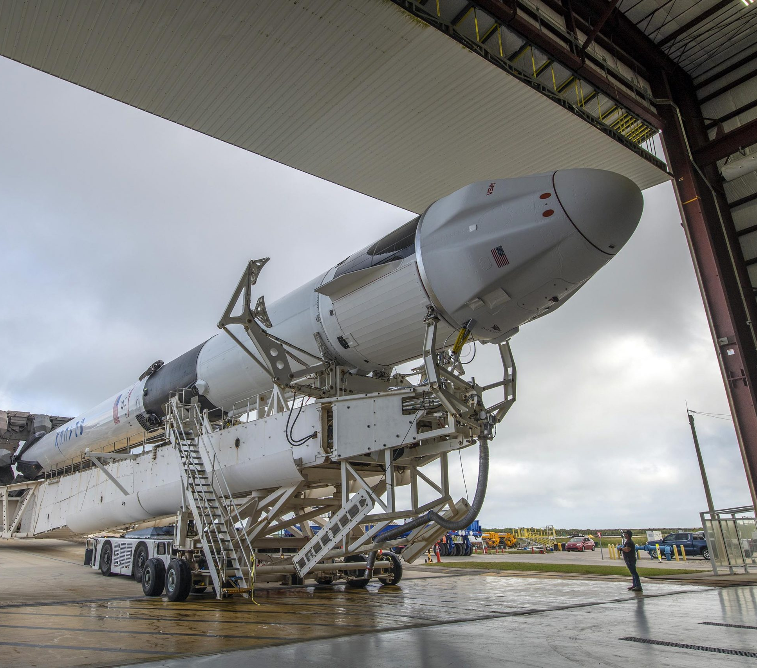
Section 1
Methodology

Slide 6
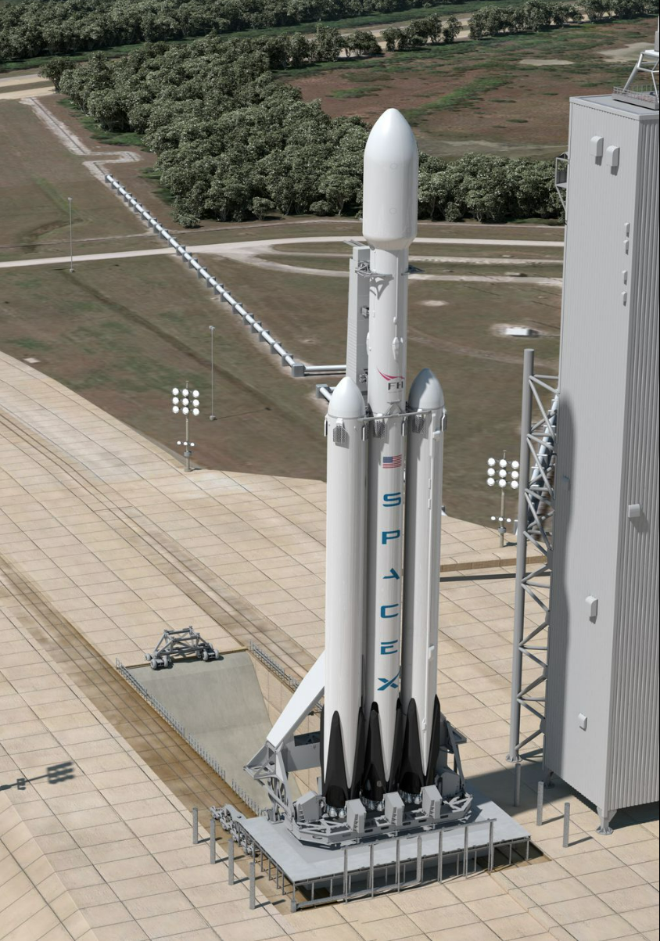
Methodology
Data collection methodology:
Combined data from SpaceX public API and web scaping SpaceX Wikipedia page
Perform data wrangling
Classifying true landings as successful and unsuccessful otherwise
Perform exploratory data analysis (EDA) using visualization and SQL
Perform interactive visual analytics using Folium and Plotly Dash
Perform predictive analysis using classification models
Using GridSearchCV to Tuned the machine learning models

Slide 7
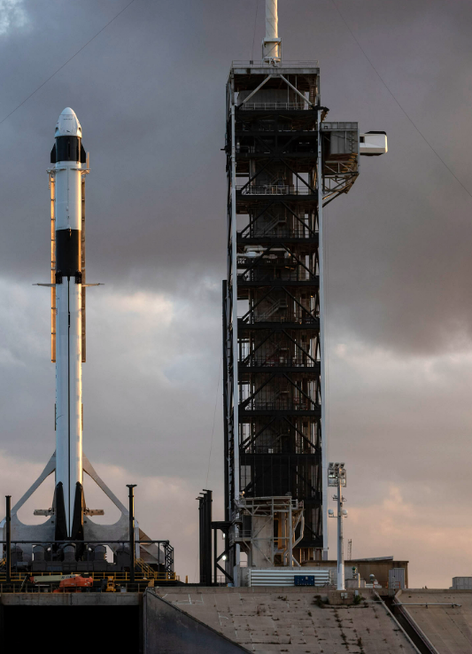
Data Collection
Data collection process involved a combination of API requests from Space X public API and web scraping data from a table in Space X’s Wikipedia entry.
The next slide will show the flowchart of data collection from API and the one after will show the flowchart of data collection from webscraping.

Slide 8
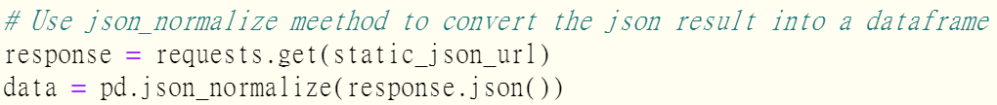
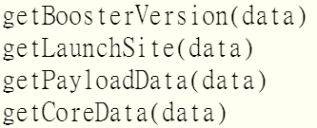
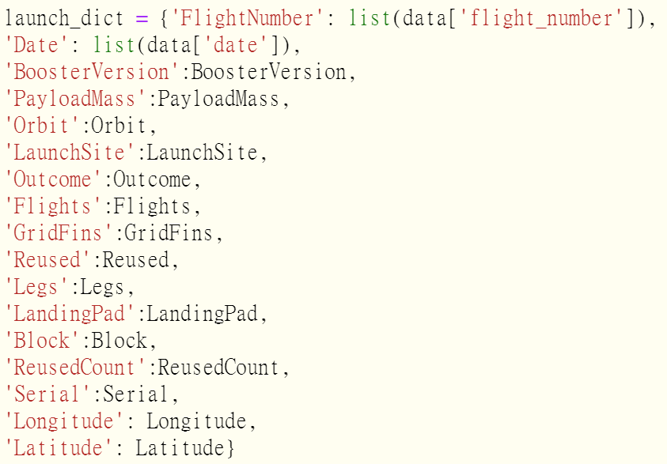
Data Collection – SpaceX API
Using the SpaceX API to retrieve data about launches, including the rocket used, payload delivered, launch specifications, landing specifications, and landing results.
Github: jupyter-labs-spacex-data-collection-api.ipynb
Getting Response from API
Converting Response to a .json file
Apply custom functions to clean data
Assign list to dictionary then dataframe
Filter dataframe and export to flat file (.csv)
1
2
3
4
5

Slide 9
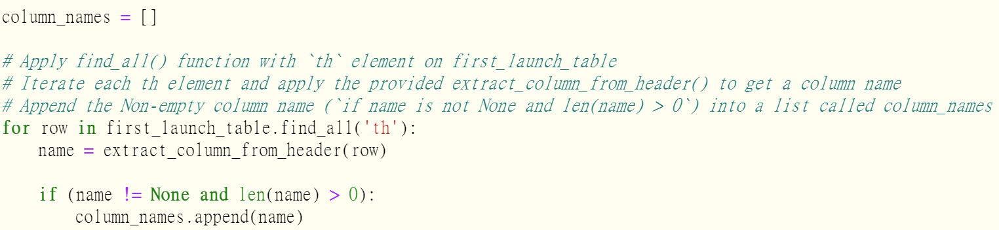
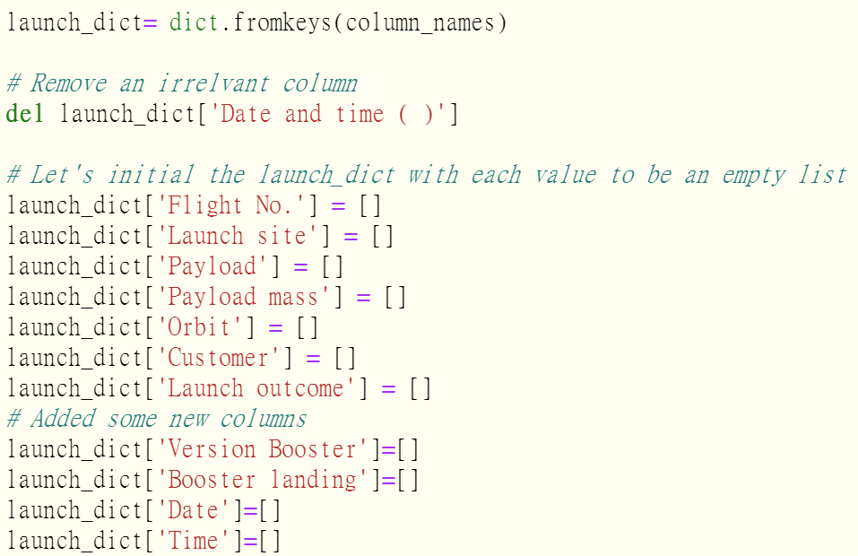
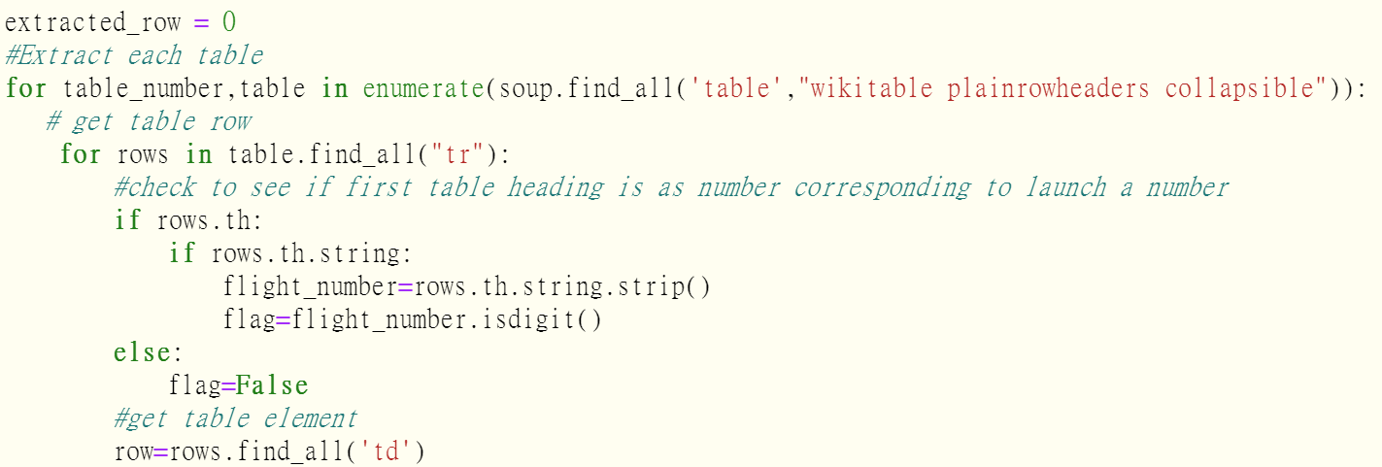
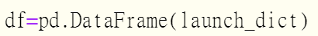
Data Collection – Scraping
1
A web scrape of historical Falcon 9 launch records was collected from the Wikipedia page titled "List of Falcon 9 and Falcon Heavy launches".
Github: jupyter-labs-webscraping.ipynb
Getting Response from HTML
Creating BeautifulSoup Object
Finding the HTML tables
Getting column names
Creation of dictionary
Appending data to dictionary
Converting dictionary to dataframe
Dataframe to .CSV
2
3
4
5
6
7
8

Slide 10

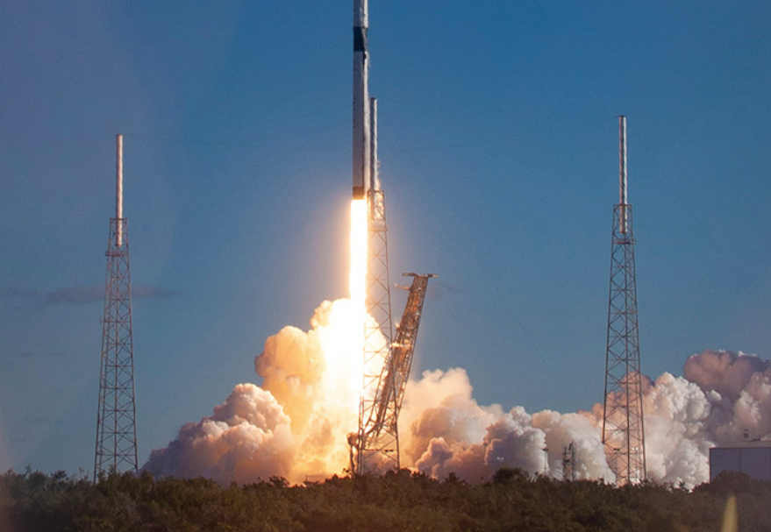


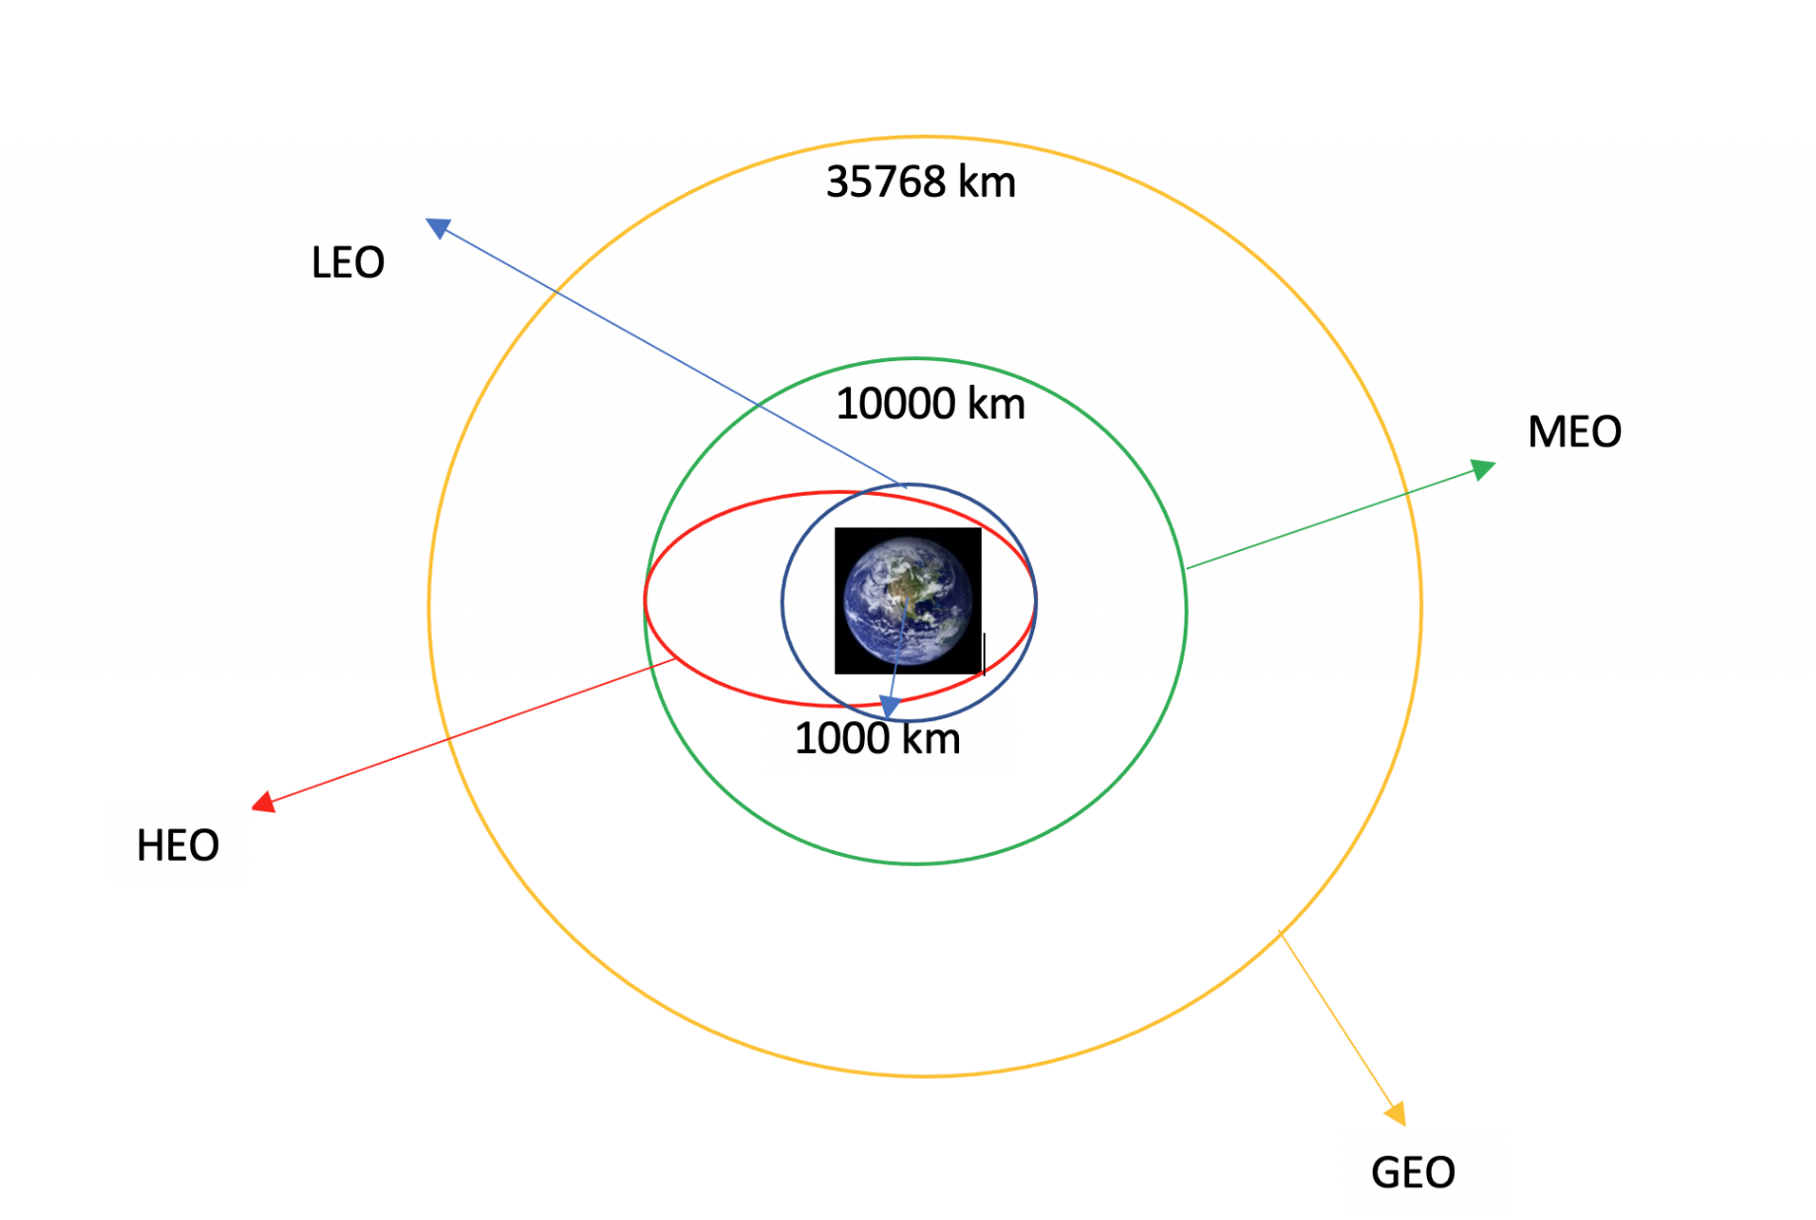

Data Wrangling
Create a label with landing outcomes where successful = 1 & failure = 0.
Outcome column has two components: ‘Mission Outcome’ ‘Landing Location’
New training label column ‘class’ with a value of 1 if ‘Mission Outcome’ is True and 0 otherwise. Value Mapping:
True ASDS, True RTLS, & True Ocean – set to -> 1
None None, False ASDS, None ASDS, False Ocean, False RTLS – set to -> 0
Github: data-wrangling.ipynb
Diagram showing common orbit types SpaceX uses

Slide 11
Exploratory Data Analysis (EDA) Visualization
BAR GRAPHS
A bar chart was produced to visualize the relationship between:
1. Success Rate and Orbit Type
A bar diagram makes it easy to compare sets of data between different groups at a glance. The graph represents categories on one axis and a discrete value in the other. The goal is to show the relationship between the two axes. Bar charts can also show big changes in data over time.
SCATTER GRAPHS
Scatter graphs were produced to visualize the relationships between:
1. Flight Number and Launch Site
2. Payload and Launch Site
3. Orbit Type and Flight Number
4. Payload and Orbit Type
Scatter plots show how much one variable is affected by another. The relationship between two variables is called their correlation . Scatter plots usually consist of a large body of data.
LINE GRAPHS
Line charts were produced to visualize the relationships between:
1. Success Rate and Year (i.e. the launch success yearly trend)
Line graphs are useful in that they show data variables and trends very clearly and can help
to make predictions about the results of data not yet recorded
Github: eda-visualization.ipynb

Slide 12
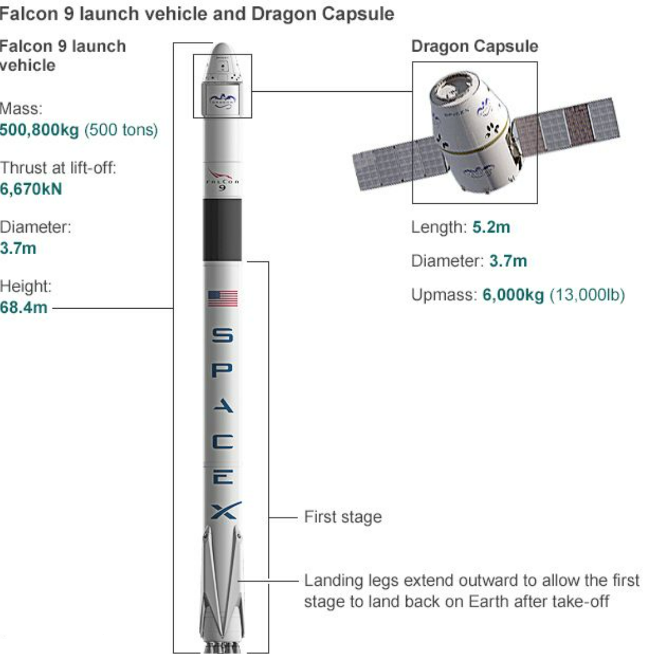
Exploratory Data Analysis (EDA) SQL
Performed SQL queries to gather information about the dataset. For example, of some questions we were asked about the data we needed information about. Which we are using SQL queries to get the answers in the dataset :
Display the names of the unique launch sites in the space mission
Display 5 records where launch sites begin with the string ‘CCA’
Display the total payload mass carried by boosters launched by NASA (CRS)
Display the average payload mass carried by booster version F9 v1.1
List the date when the first successful landing outcome on a ground pad was achieved
List the names of the boosters which had success on a drone ship and a payload mass between 4000 and 6000 kg
List the total number of successful and failed mission outcomes
List the names of the booster versions which have carried the maximum payload mass
List the failed landing outcomes on drone ships, their booster versions, and launch site names for 2015
Rank the count of landing outcomes (such as Failure (drone ship) or Success (ground pad)) between the date 2010-06-04 and 2017-03-20, in descending order

Slide 13
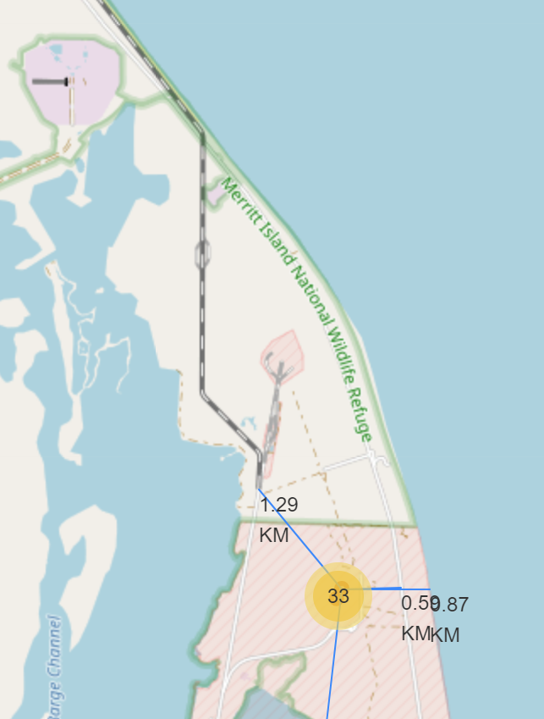
Building an interactive map with Folium
To visualize the Launch Data into an interactive map.
Initialise the map using a Folium Map object
Add a folium.Circle and folium.Marker for each launch site on the launch map
We assigned the dataframe launch_outcomes(failures, successes) to classes 0 and 1.
As many launches have the same coordinates, it makes sense to cluster them together.
Before clustering them, assign a marker colour of successful (class = 1) as green, and failed (class = 0) as red.
To put the launches into clusters, for each launch, add a folium.Marker to the MarkerCluster() object.
Create an icon as a text label, assigning the icon_color as the marker_colour determined previously.
Using Haversine’s formula we calculated the distance
To explore the proximities of launch sites, calculations of distances between points can be made using the Lat and Long values.
After marking a point using the Lat and Long values, create a folium.Marker object to show the distance.
To display the distance line between two points, draw a folium.PolyLine and add this to the map.
Github: launch-site-location.ipynb

Slide 14
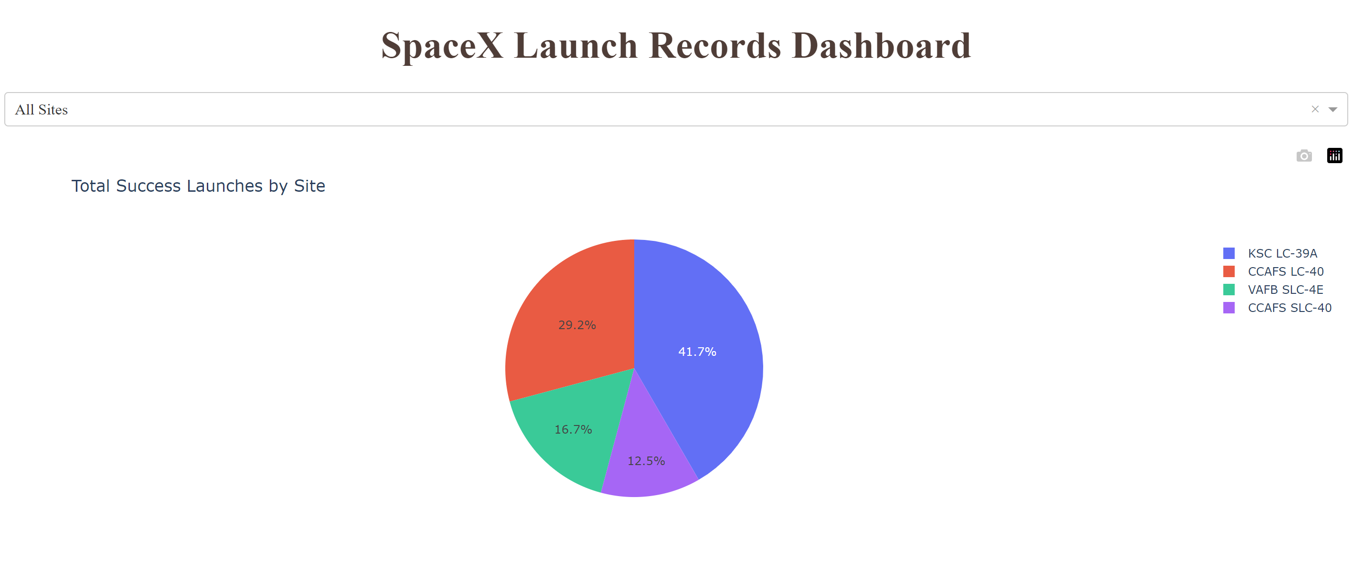
Build a Dashboard with Plotly Dash
Dashboard includes a pie chart and a scatter plot.
Pie chart (px.pie()) showing the total successful launches per site
This makes it clear to see which sites are most successful
The chart could also be filtered (using a dcc.Dropdown() object) to see the success/failure ratio for an individual site
Scatter graph (px.scatter()) to show the correlation between outcome (success or not) and payload mass (kg)
This could be filtered (using a RangeSlider() object) by ranges of payload masses
It could also be filtered by booster version
Github: spacex_dash_app.py

Slide 15
Predictive Analysis (Classification)
1. BUILDING MODEL
• Load our dataset into NumPy and Pandas
• Transform Data
• Split our data into training and test data sets
• Check how many test samples we have
• Decide which type of machine learning algorithms we want to use
• Set our parameters and algorithms to GridSearchCV
• Fit our datasets into the GridSearchCV objects and train our dataset.
2. EVALUATING MODEL
• Check accuracy for each model
• Get tuned hyperparameters for each type of algorithms
• Plot Confusion Matrix
3. IMPROVING MODEL
• Feature Engineering
• Algorithm Tuning
4. FINDING THE BEST PERFORMING CLASSIFICATION MODEL
• The model with the best accuracy score wins the best performing model
• In the notebook there is a dictionary of algorithms with scores at the bottom of the notebook.
Github: SpaceX Machine Learning Prediction

Slide 16

Results
Exploratory Data Analysis
Interactive Analytics
Predictive Analysis

Slide 17
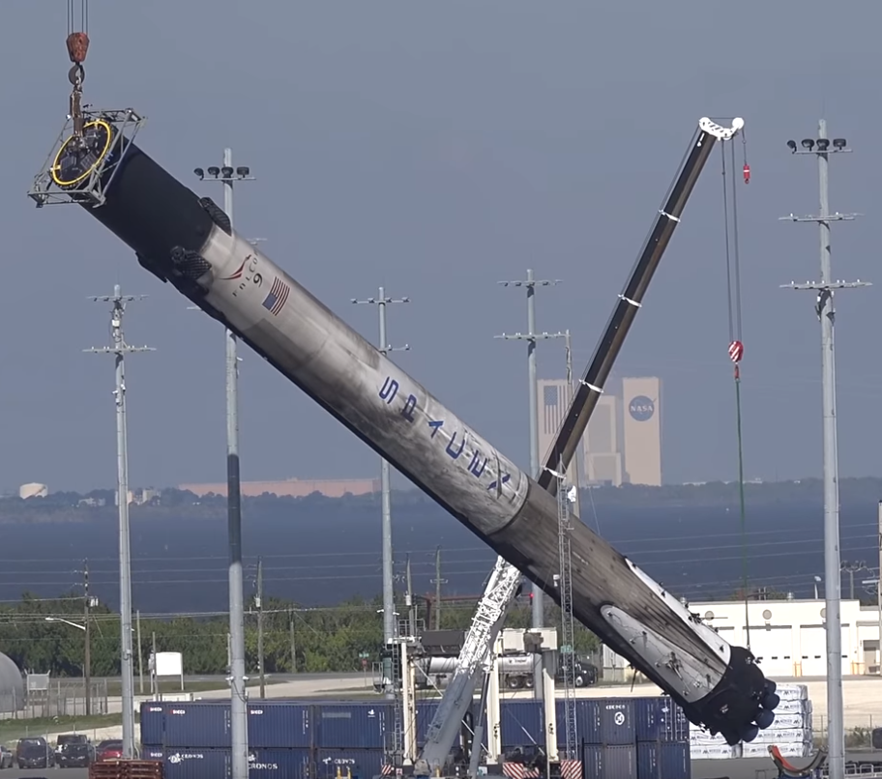
Section 2
EDA with Visualization

Slide 18
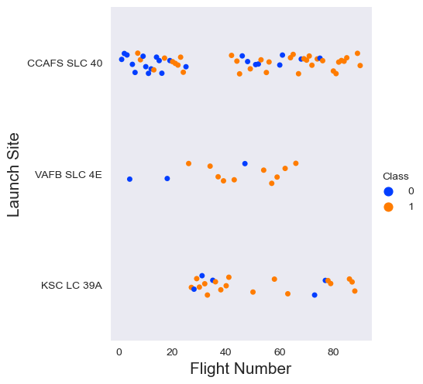
Flight Number vs Launch Site
The scatter plot of Launch Site vs Flight Number shows that:
The more flights at the launch site, the higher the success rate of the launch site
Early flights (flight numbers < 30) were launched from CCAFS SLC 40 but were usually unsuccessful.
While flights from VAFB SLC 4E also showed this trend, the earlier flights were less successful.
KSC LC 39A did not launch earlier flights, so launches from this site were more successful.
Flights number more than 30, there are much more successful landings (level = 1).

Slide 19
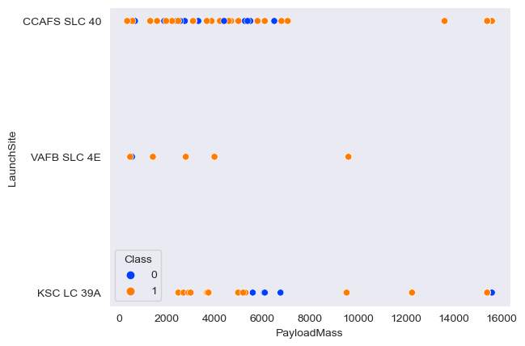
Payload vs Launch Site
The scatter plot of Launch Site vs Payload shows that:
Green indicates a successful launch; purple indicates a failed launch.
Payload mass seems to fall mostly between 0-6000kg. Very few successful landings above a payload mass of about 7,000kg, but there is also much less data on these heavier launches.
No clear correlation between payload mass and success rate for a given launch site.
Different launch sites also appear to use different payload masses. All sites launched a variety of payload masses, with most launches from CCAFS SLC 40 being relatively light payloads (with some outliers).

Slide 20
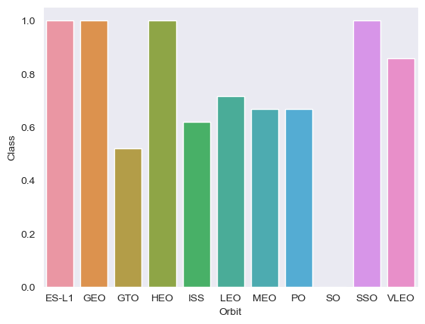
Success Rate vs Orbit Type
A bar graph of success rate versus orbit type shows that the following tracks have the highest (100%) success rate:
ES-L1 (1), GEO (1), HEO (1) have 100% success rate (sample sizes in parenthesis) SSO (5) has 100% success rate
VLEO (14) has decent success rate and attempts
GTO (27) has the around 50% success rate but largest sample
SO (1) has 0% success rate

Slide 21
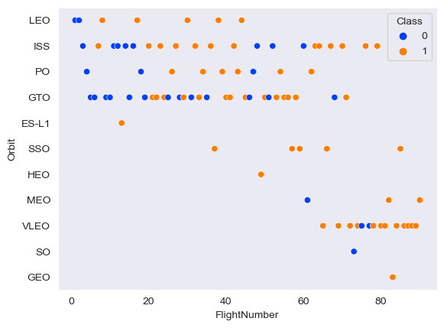
Flight Number vs Orbit type
The scatterplot of orbit types versus flight numbers shows some useful things that the previous plots did not, such as:
Launch Orbit preference changed to Flight Number.
Launch Outcome seems to correlate with this preference.
SpaceX started in LEO orbit, had some success in LEO, and returned to VLEO for recent launches
SpaceX seems to do better in lower or sun-synchronous orbits

Slide 22
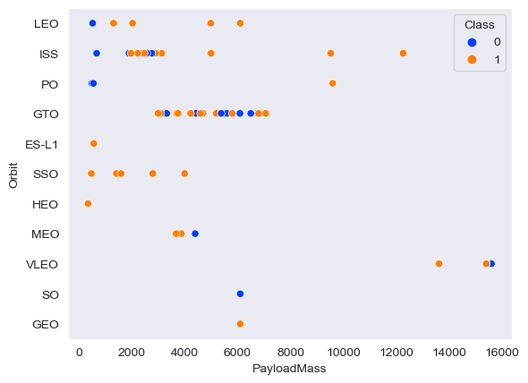
Payload vs Orbit type
This scatter plot of Orbit Type vs Payload Mass shows that:
Payload mass appears to be orbit-dependent
PO, International Space Station and Leo track are more successful with heavy loads
For GTO, the relationship between payload mass and success rate is unclear.
Another most successful orbital VLEO only has payload mass values at the high end of the range

Slide 23
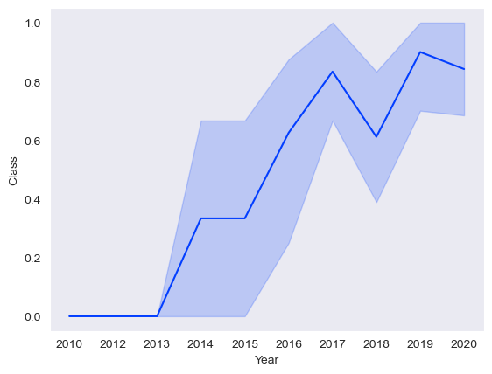
Launch Success Yearly Trend
The line chart of yearly average success rate shows that:
Between 2010 and 2013, all landings were unsuccessful (as the success rate is 0).
Success generally increases over time since 2013 with a slight dip in 2018
Success in recent years at around 80%

Slide 24
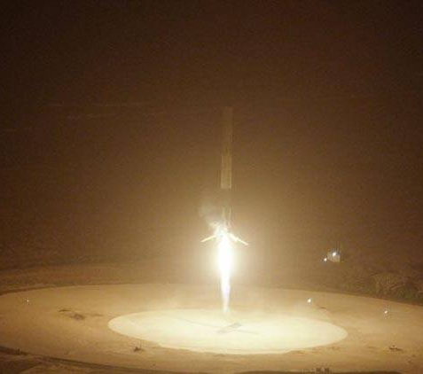
Section 3
EDA with SQL

Slide 25
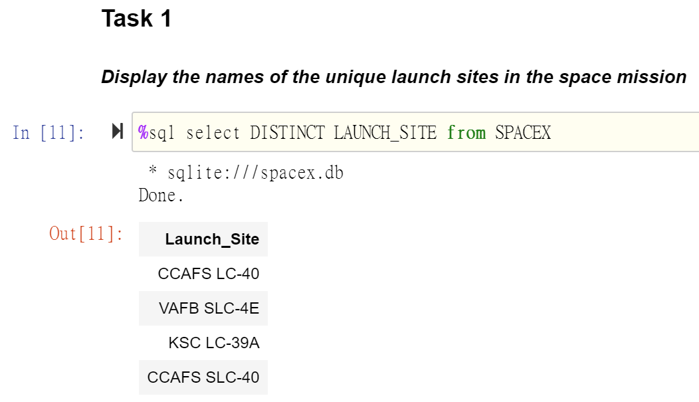
All Launch Site Names
Find the names of the unique launch sites.
． Using the word DISTINCT in the query means that it will only
． Show Unique values in the Launch_Site column from tblSpaceX

Slide 26
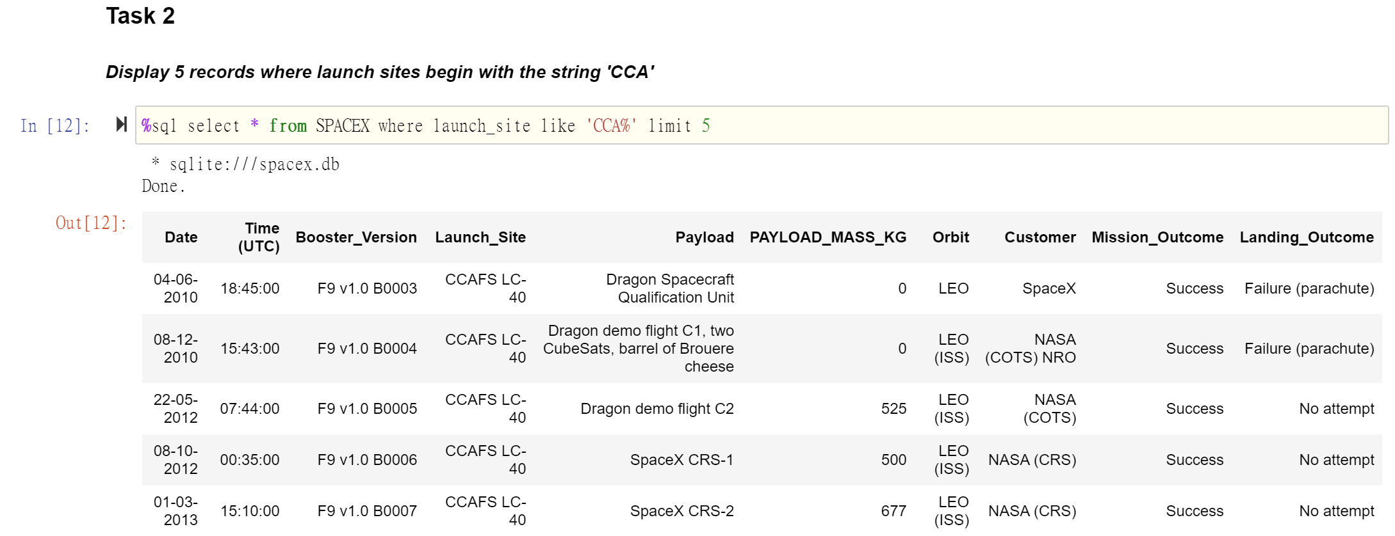
Launch Site Names Beginning with `CCA`
Find 5 records where launch sites begin with ‘CCA’.
．Using LIMIT 5 fetches only 5 records, and the LIKE keyword is used with the wild card ‘CCA%’ to retrieve string values beginning with ‘CCA’.

Slide 27
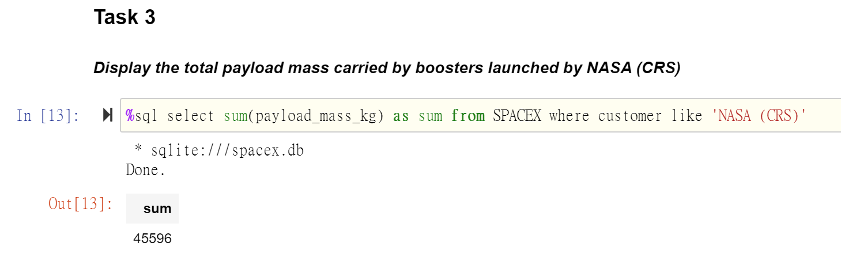
Total Payload Mass
Calculate the total payload carried by boosters from NASA.
． This query sums the total payload mass in kg where NASA was the customer.
． CRS stands for Commercial Resupply Services which indicates that these payloads were sent to the International Space Station (ISS).

Slide 28
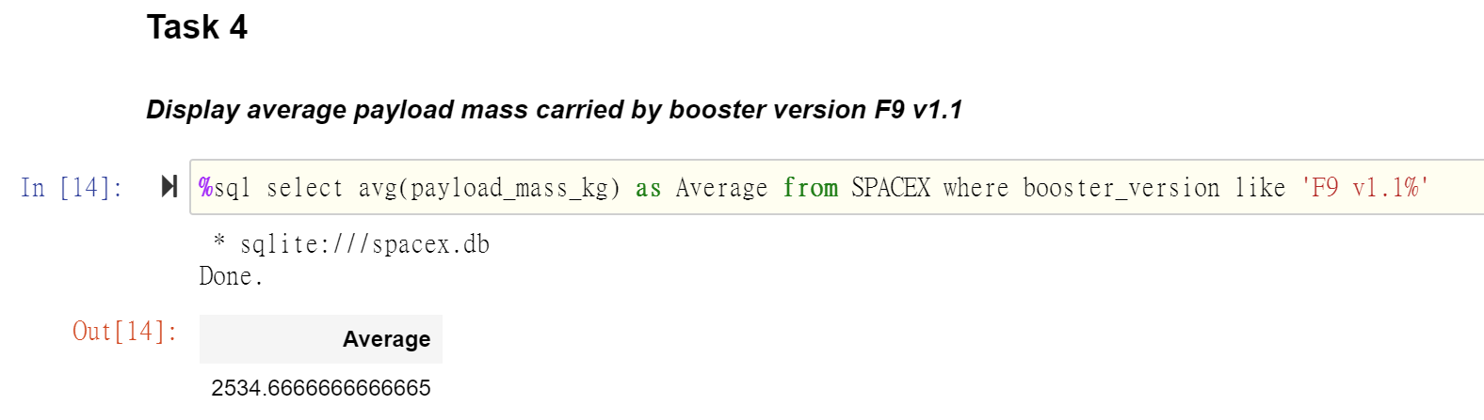
Average Payload Mass by F9 v1.1
Calculate the average payload mass carried by booster version F9 v1.1.
． This query calculates the average payload mass or launches which used booster version F9 v1.1
． Average payload mass of F9 1.1 is on the low end of our payload mass range

Slide 29
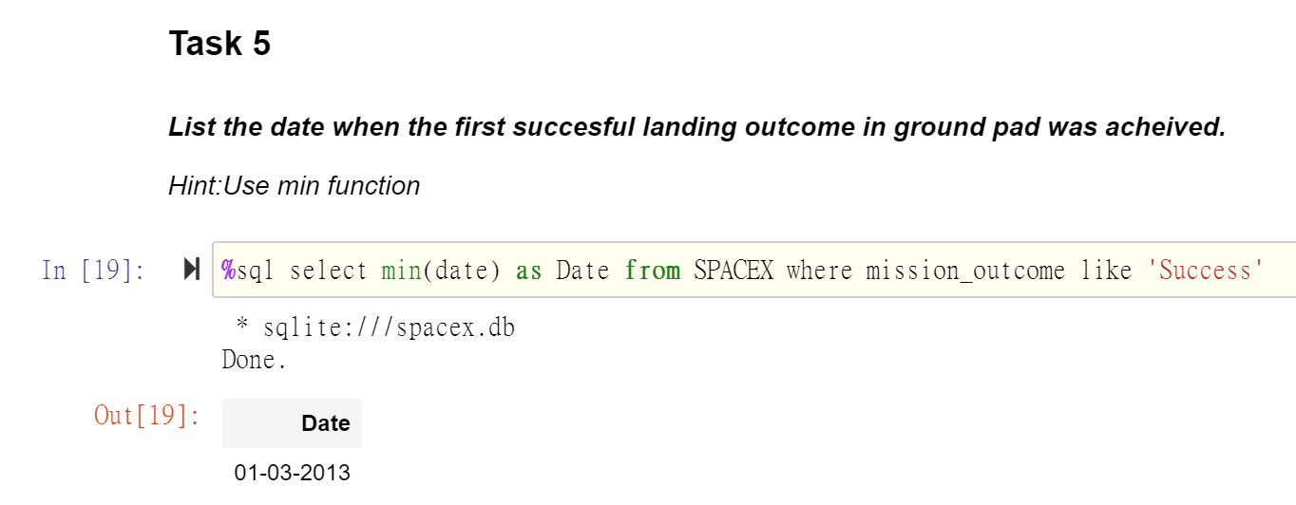
First Successful Ground Landing Date
Find the dates of the first successful landing outcome on ground pad.
． This query returns the first successful ground pad landing date.
． First ground pad landing wasn’t until the end of 2015.
． Successful landings in general appear starting 2014.

Slide 30
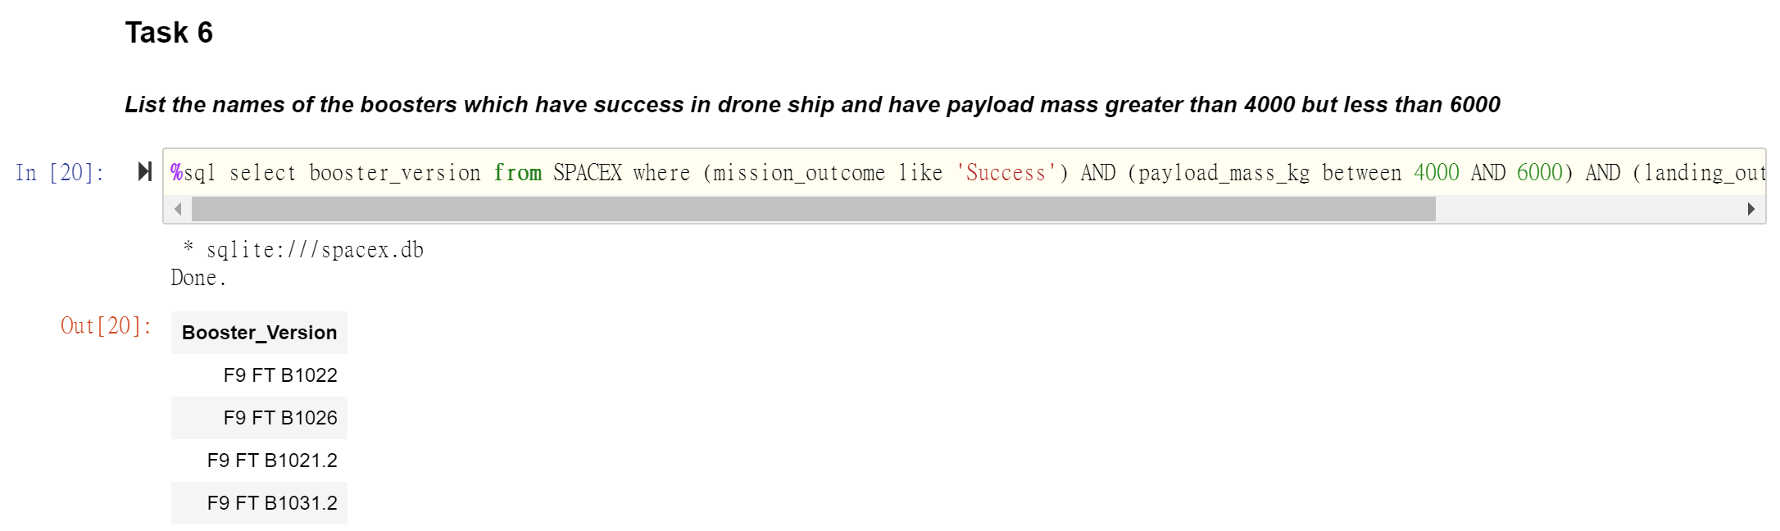
Successful Drone Ship Landing with Payload between 4000 and 6000
List the names of boosters which have successfully landed on drone ship and had payload mass greater than 4000 but less than 6000.
． This query returns the four booster versions that had successful drone ship landings and a payload mass between 4000 and 6000 noninclusively.

Slide 31
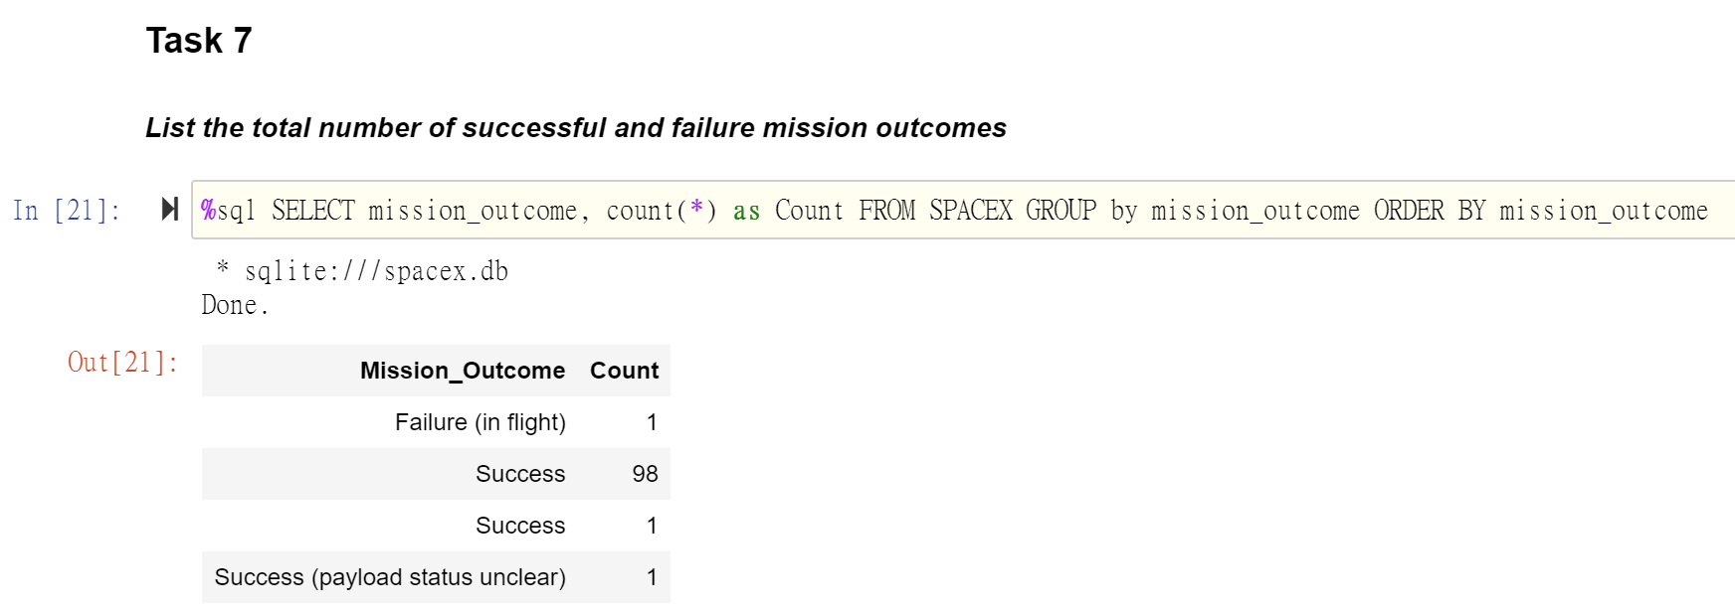
Total Number of Successful and Failure Mission Outcomes
Calculate the total number of successful and failure mission outcome.
． This query returns a count of each mission outcome.
． SpaceX appears to achieve its mission outcome nearly 99% of the time.
． This means that most of the landing failures are intended.
． Interestingly, one launch has an unclear payload status and unfortunately one failed in flight.

Slide 32
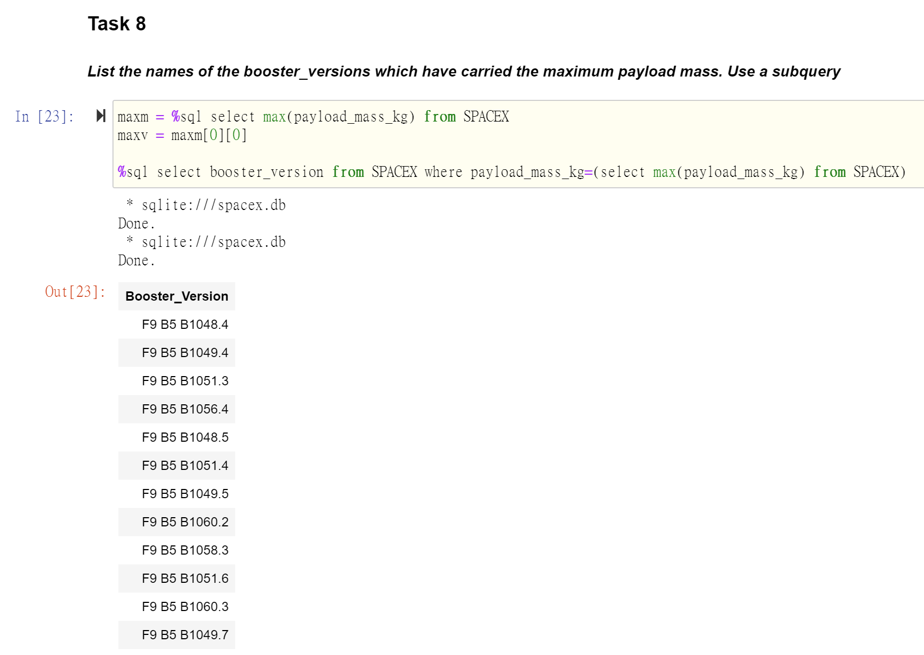
Boosters Carried Maximum Payload
List the names of the booster which have carried the maximum payload mass.
． This query returns the booster versions that carried the highest payload mass of 15600 kg.
． These booster versions are very similar and all are of the F9 B5 B10xx.x variety.
． This likely indicates payload mass correlates with the booster version that is used.

Slide 33
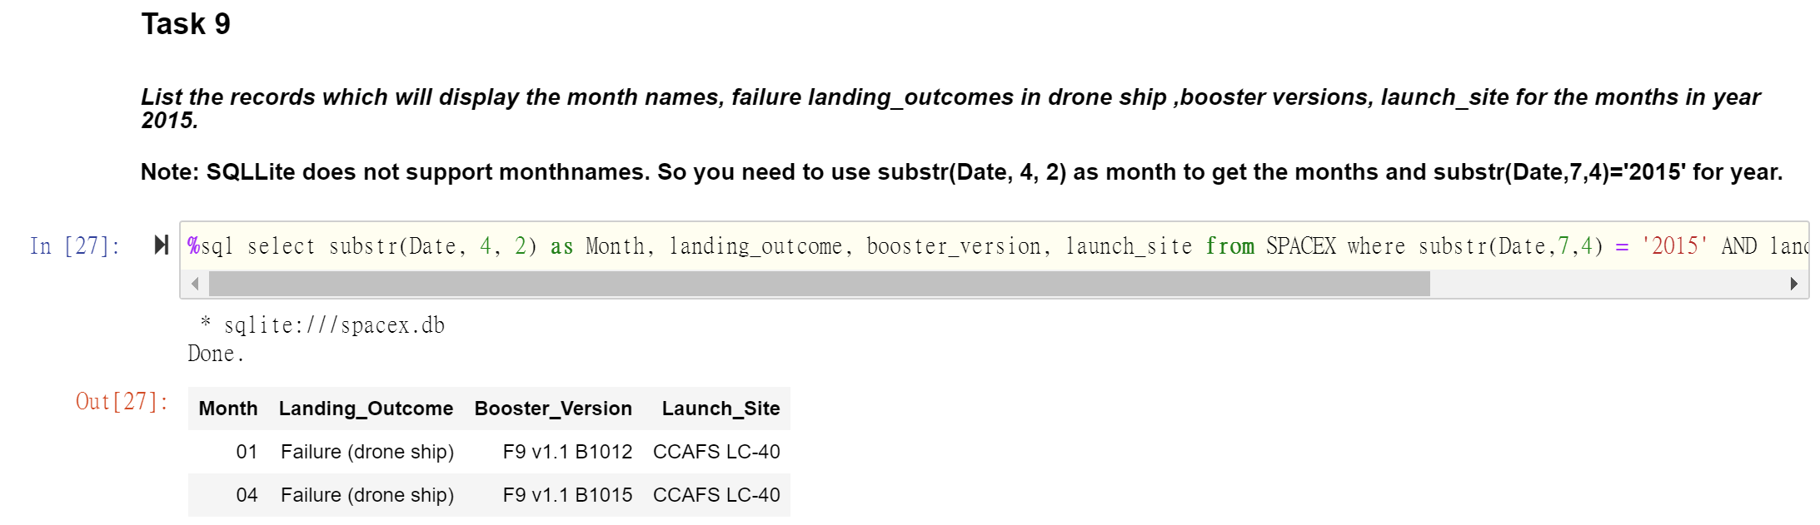
2015 Launch Records
List the failed landing_outcomes in drone ship, their booster versions, and launch site names for in year 2015.
． This query returns the Month, Landing Outcome, Booster Version, Payload Mass (kg), and Launch site of 2015 launches where stage 1 failed to land on a drone ship.
． There were two such occurrences.

Slide 34
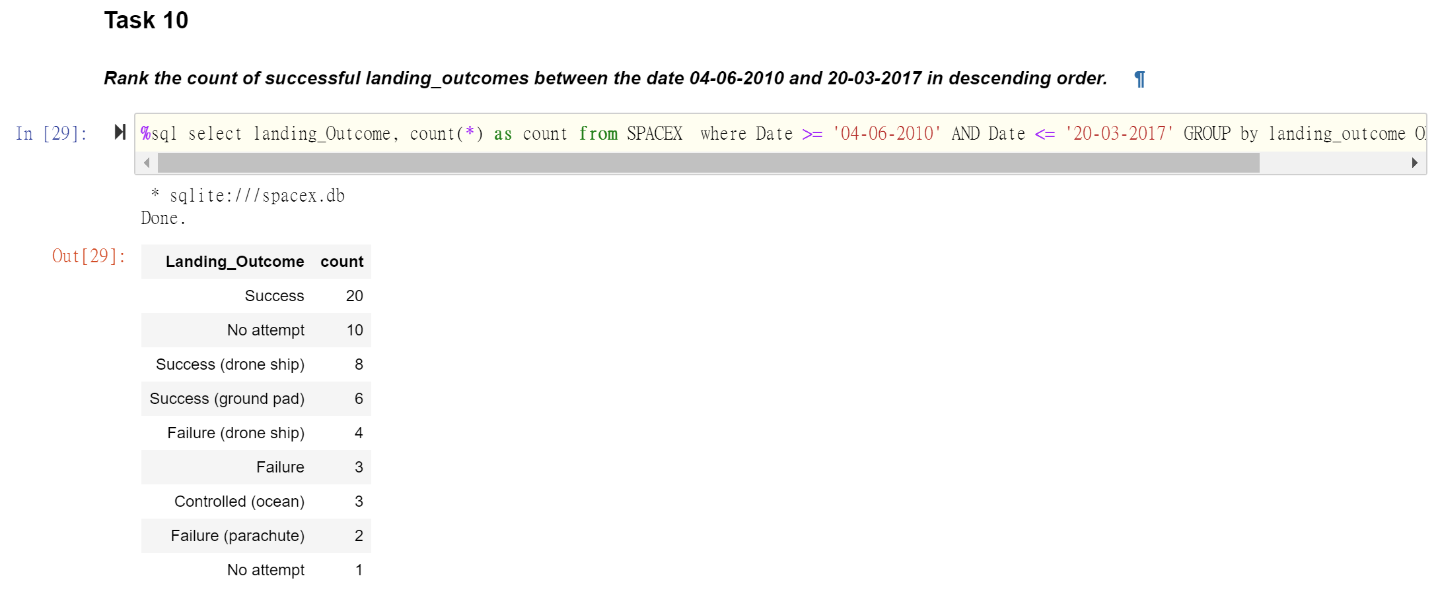
Rank Landing Outcomes Between 2010-06-04 and 2017-03-20
Rank the count of landing outcomes (such as Failure (drone ship) or Success (ground pad)) between the date 2010-06-04 and 2017-03-20, in descending order.
． This query returns a list of successful landings and between 2010-06-04 and 2017-03-20 inclusively.
． There are two types of successful landing outcomes: drone ship and ground pad landings.
． There were 8 successful landings in total during this time period

Slide 35

Section 4
Interactive Map

Slide 36

Launch Site Locations
The left map shows all launch sites relative US map. The right map shows the two Florida launch sites since they are very close to each other. All launch sites are near the ocean.

Slide 37

Color-Coded Launch Markers
Clusters on Folium map can be clicked on to display each successful landing (green icon) and failed landing (red icon). In this example VAFB SLC-4E shows 4 successful landings and 6 failed landings.

Slide 38



Key Location Proximities
Using KSC LC-39A as an example, launch sites are very close to railways for large part and supply transportation. Launch sites are close to highways for human and supply transport. Launch sites are also close to coasts and relatively far from cities so that launch failures can land in the sea to avoid rockets falling on densely populated areas.

Slide 39
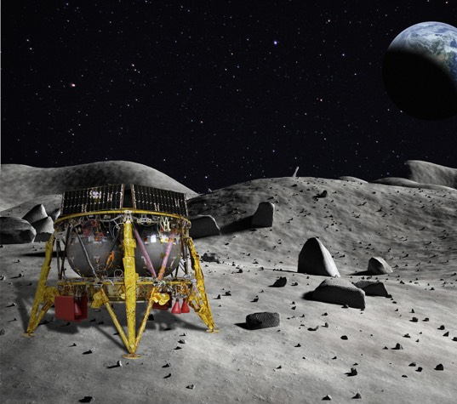
Section 5
Dashboard

Slide 40
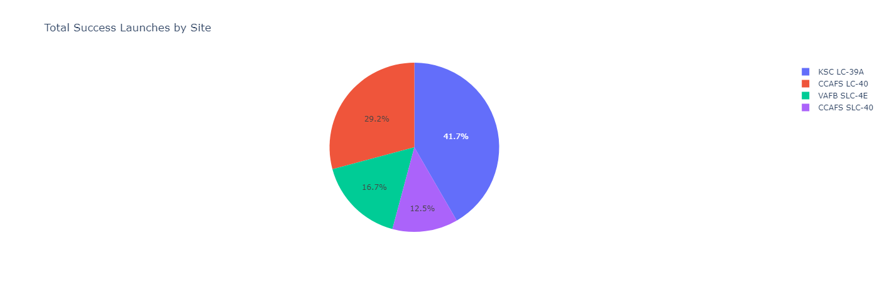
Successful Launches Across Launch Sites
The launch site KSC LC-39 A had the most successful launches, with 41.7% of the total successful launches.

Slide 41
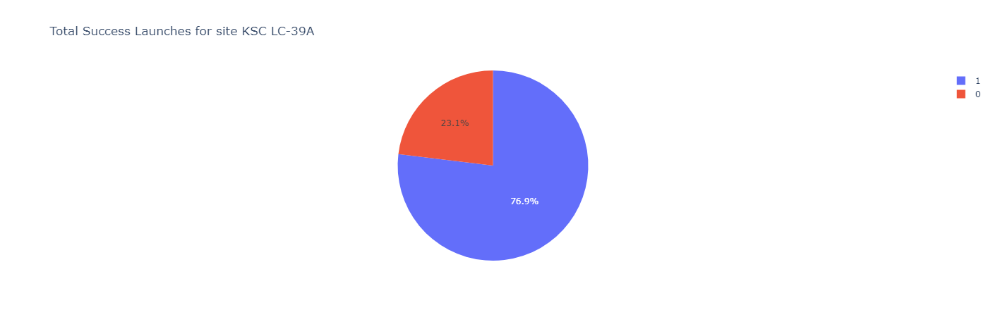
Successful Launches Across Launch Sites
The launch site KSC LC-39 A also had the highest rate of successful launches, with a 76.9% success rate.

Slide 42

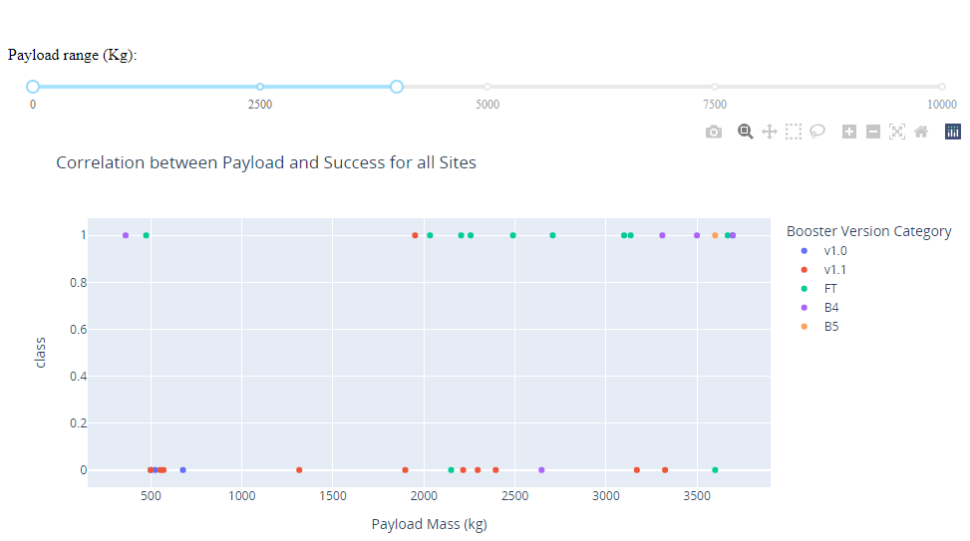
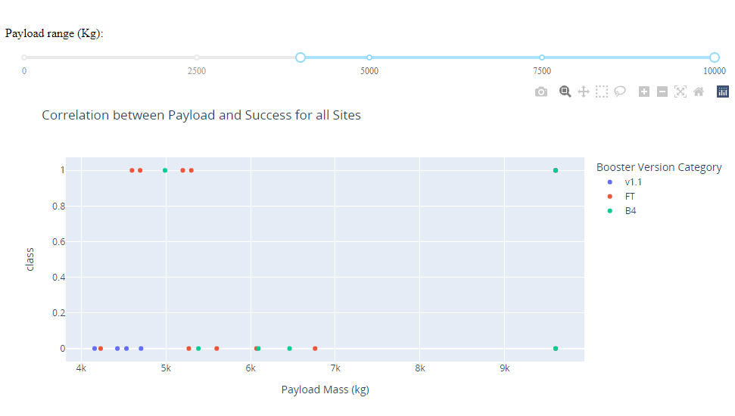
Successful Launches Across Launch Sites
1
2
Plotting the launch outcome vs. payload for all sites shows a gap around 4000 kg, so it makes sense to split the data into 2 ranges:
0 – 4000 kg (low payloads)
4000 – 10000 kg (massive payloads)
From these 2 plots, it can be shown that the success for massive payloads is lower than that for low payloads.
It is also worth noting that some booster types (v1.0 and B5) have not been launched with massive payloads.

Slide 43
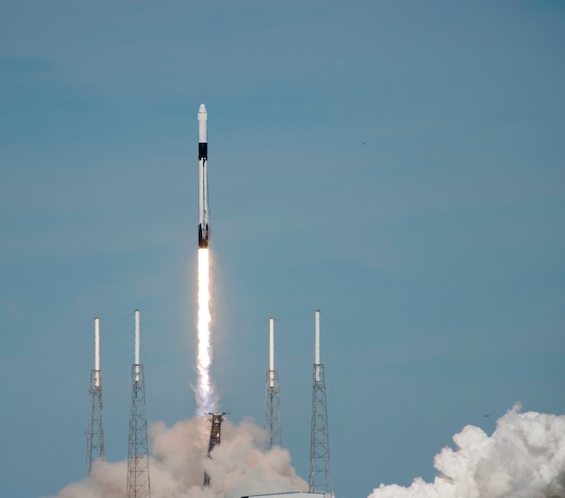
Section 5
Predictive Analysis (Classification)

Slide 44
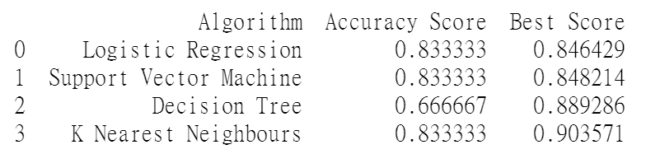
Classification Accuracy
Accuracy Score and Best Score for each classification algorithm produces the following result:
The KNN model has the highest classification accuracy:
The Accuracy Score is 83.33%
The Best Score is 90.36%

Slide 45
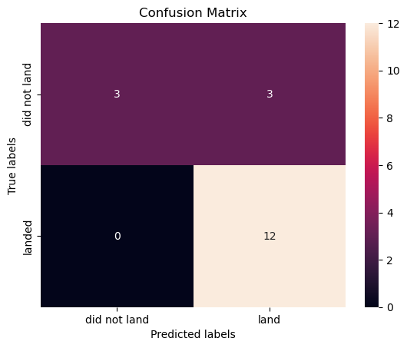
Confusion Matrix
As shown previously, best performing classification model is the KNNmodel, with an accuracy of 83.33%.
Correct predictions are on a diagonal from top left to bottom right.

Slide 46
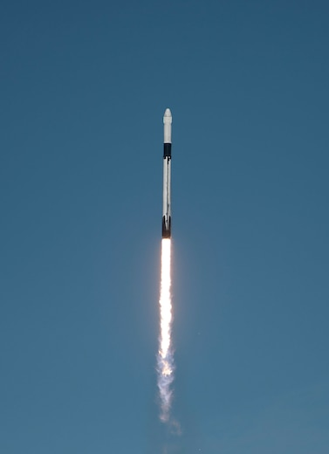
Conclusions
Our mission: Develop a machine learning model for Space Y, which wants to bid against SpaceX
The goal of the model is to predict when the first stage will land successfully to save about $100 million
Data used comes from public SpaceX API and web scraping SpaceX Wikipedia page
Create data tags and store data into SQLite database
Created a dashboard for the visualization
We created a machine learning model with 83% accuracy
SpaceY's Allon Mask can use this model to more accurately predict whether a launch will successfully land on Stage 1 before launch, so as to decide whether to launch
If possible, more data should be collected to better identify the best machine learning model and improve accuracy

Slide 47
Appendix

Slide 48
Appendix
GitHub: IBM_Data_Science_Course

Slide 49

Thank You!

